Slide 1
Machine Learning on Dataset

Slide 2
ML Model
Loading the Dataset
Load into pandas as DataFrame
Observe the sample in the dataset
head()
tail()
Check for missing values
Imputation
Fill the continuous column – mean/median
Categorical column – Mode
Drop the Rows/Columns (if more than 30% is missing then drop it )
Validate the Data Types – df.info()
Coerce into the required data type (Example: pd.to_numeric, series.str)
Create the Plot →
Univariate
Bi Variate
Multi Variate plot

Slide 3
ML Model
Data Transformation based on the EDA (plots)
Data Extraction ( Example: Extract day from date column, Extract week from date column)
Ensure that all the columns is numeric
Apply Label Encoder on Categorical features (Ordinal features)
Apply OneHotEncoder on Categorical features (Nominal features)
Apply LabelEncoder on the Output column (if it contains categorical data)
Describe the numerical properties of the dataset. (df.describe() )
Split into 2 parts (training set and test set)
Apply the Scaling – StandardScaler()
fit_transform – Training dataset
transform – test dataset
Apply the model
Perform Evaluation
Check the Assumptions of the Model
Hyperparameter Tuning
Save the Model (Serialization)

Slide 4
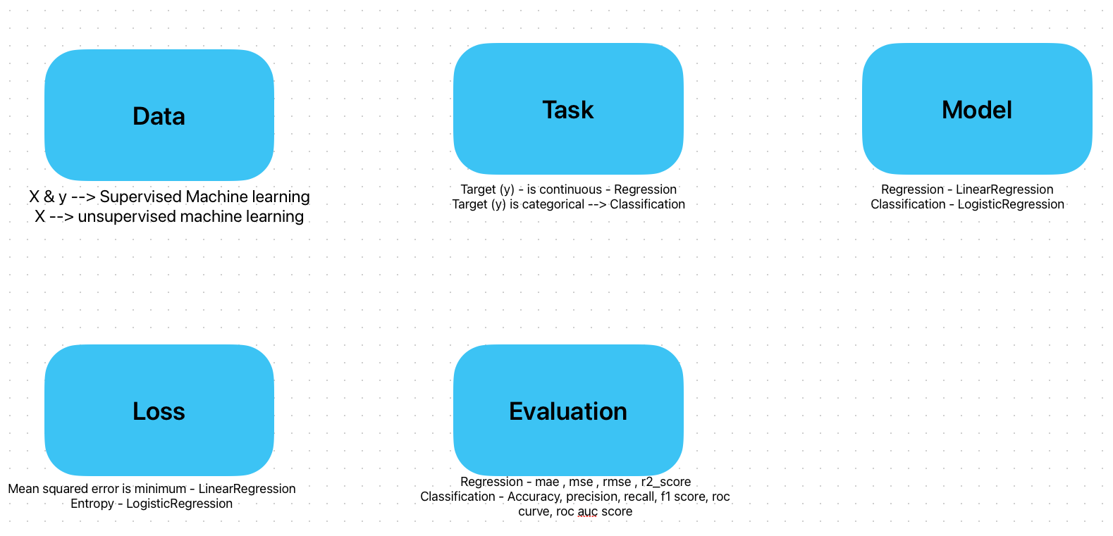

Slide 5
Additional Resources
https://fastapi.tiangolo.com/ - FastAPI
Docker Containers for Machine Learning Deployment – https://www.youtube.com/watch?v=WhENkRjBNEc&pp=ygUUbWFuaWZvbGQgYWkgbGVhcm5pbmc%3D

